Slide 1
SQA Network Event HN Administration & IT Centre Update
Sandra Ferguson
Curriculum Manager - Business and Computing
Ayr Campus

Slide 2
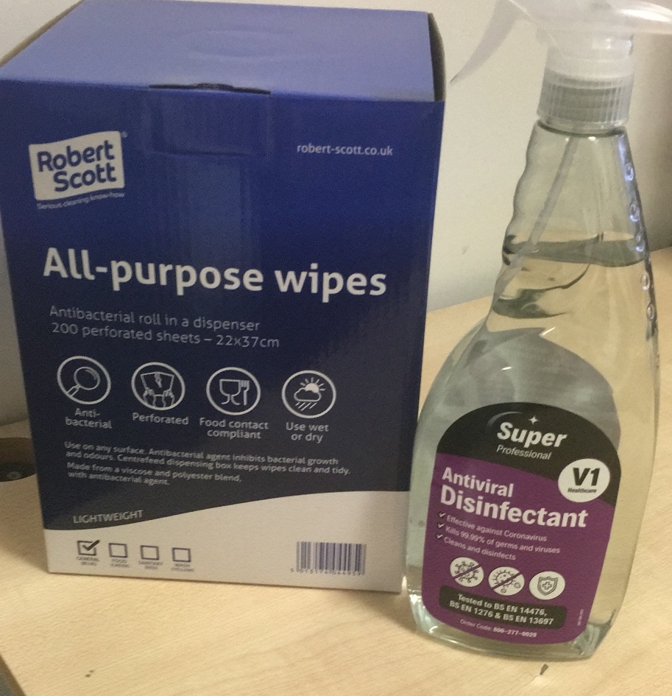
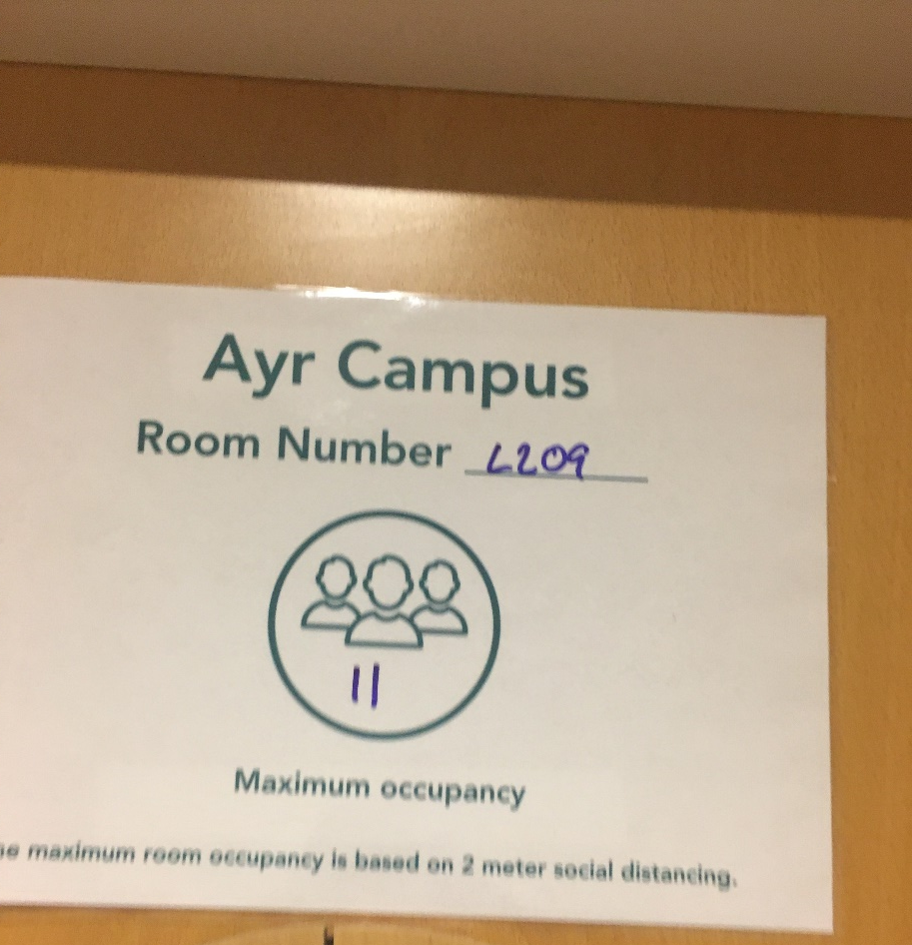
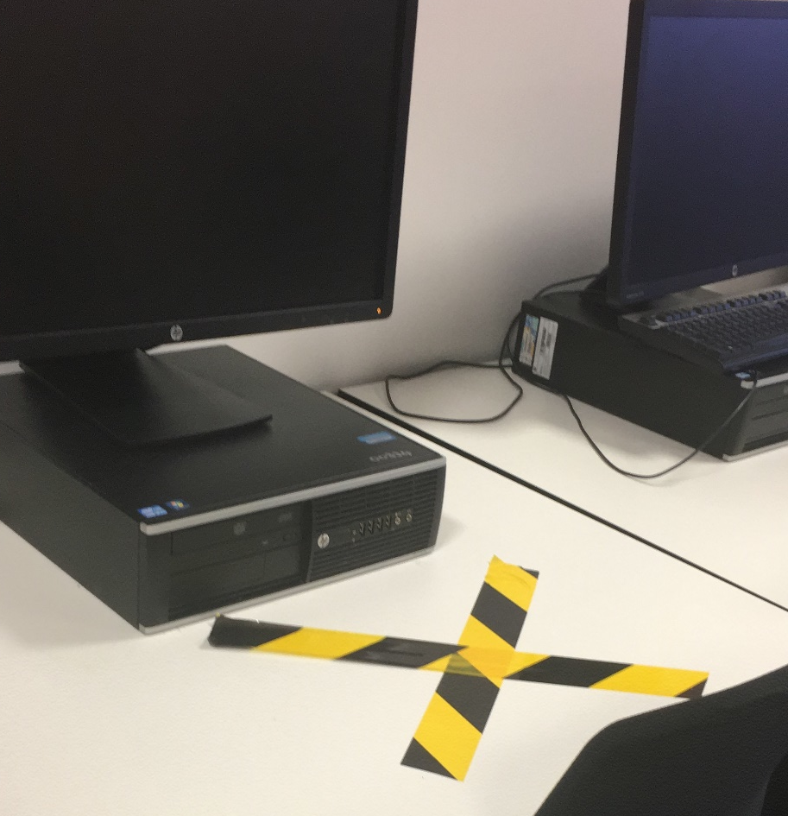
Session 2020 - 2021

Slide 3
Session 2020 - 2021
Curriculum Areas empowered to make decisions on delivery
Blended Curriculum Delivery
Course Teams Group Chat to prioritise units for on-campus delivery
Original timetable amended to Blended Learning Timetable
Students split into 2 groups for on-campus learning
On-campus once per fortnight due to class sizes
In-class/remote synchronised class delivery
On-campus Course Induction for all students

Slide 4
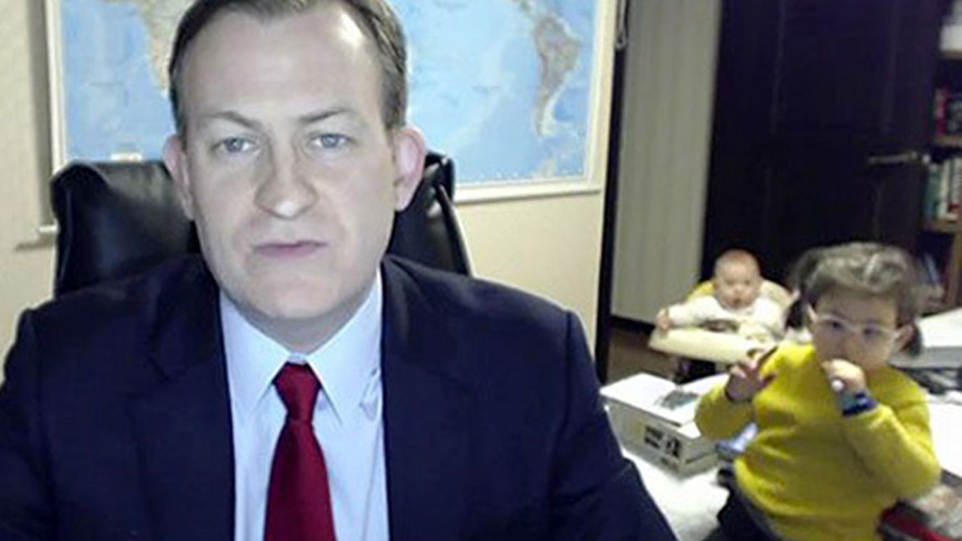
Getting to know our students remotely…
I’m so sorry
Hello there!
I’m so embarrassed
What are your names?
I can’t believe it
*waving at children*

Slide 5
Remote Delivery Experiences…
Microsoft Teams used for main delivery
Format varied depending on unit and level
Live classes delivered for all units, recorded for reference purposes
Supported with short videos detailing skills being developed where required
Class Notebook (OneNote) used to store lesson plans providing flexibility for learners and collaboration space
Inject elements of fun; Kahoot Quiz, setting challenges, Bitmojis…
My Learning (Moodle) embedded into Teams pages

Slide 6
Course Teams page

Slide 7
HNC Administration & IT

Slide 8
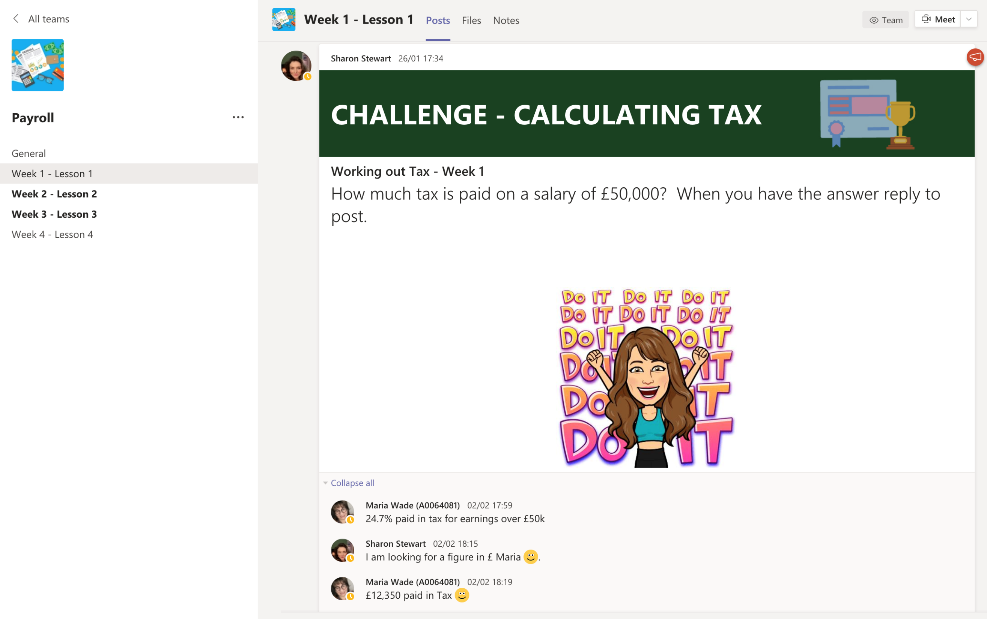
HNC Administration & IT

Slide 9
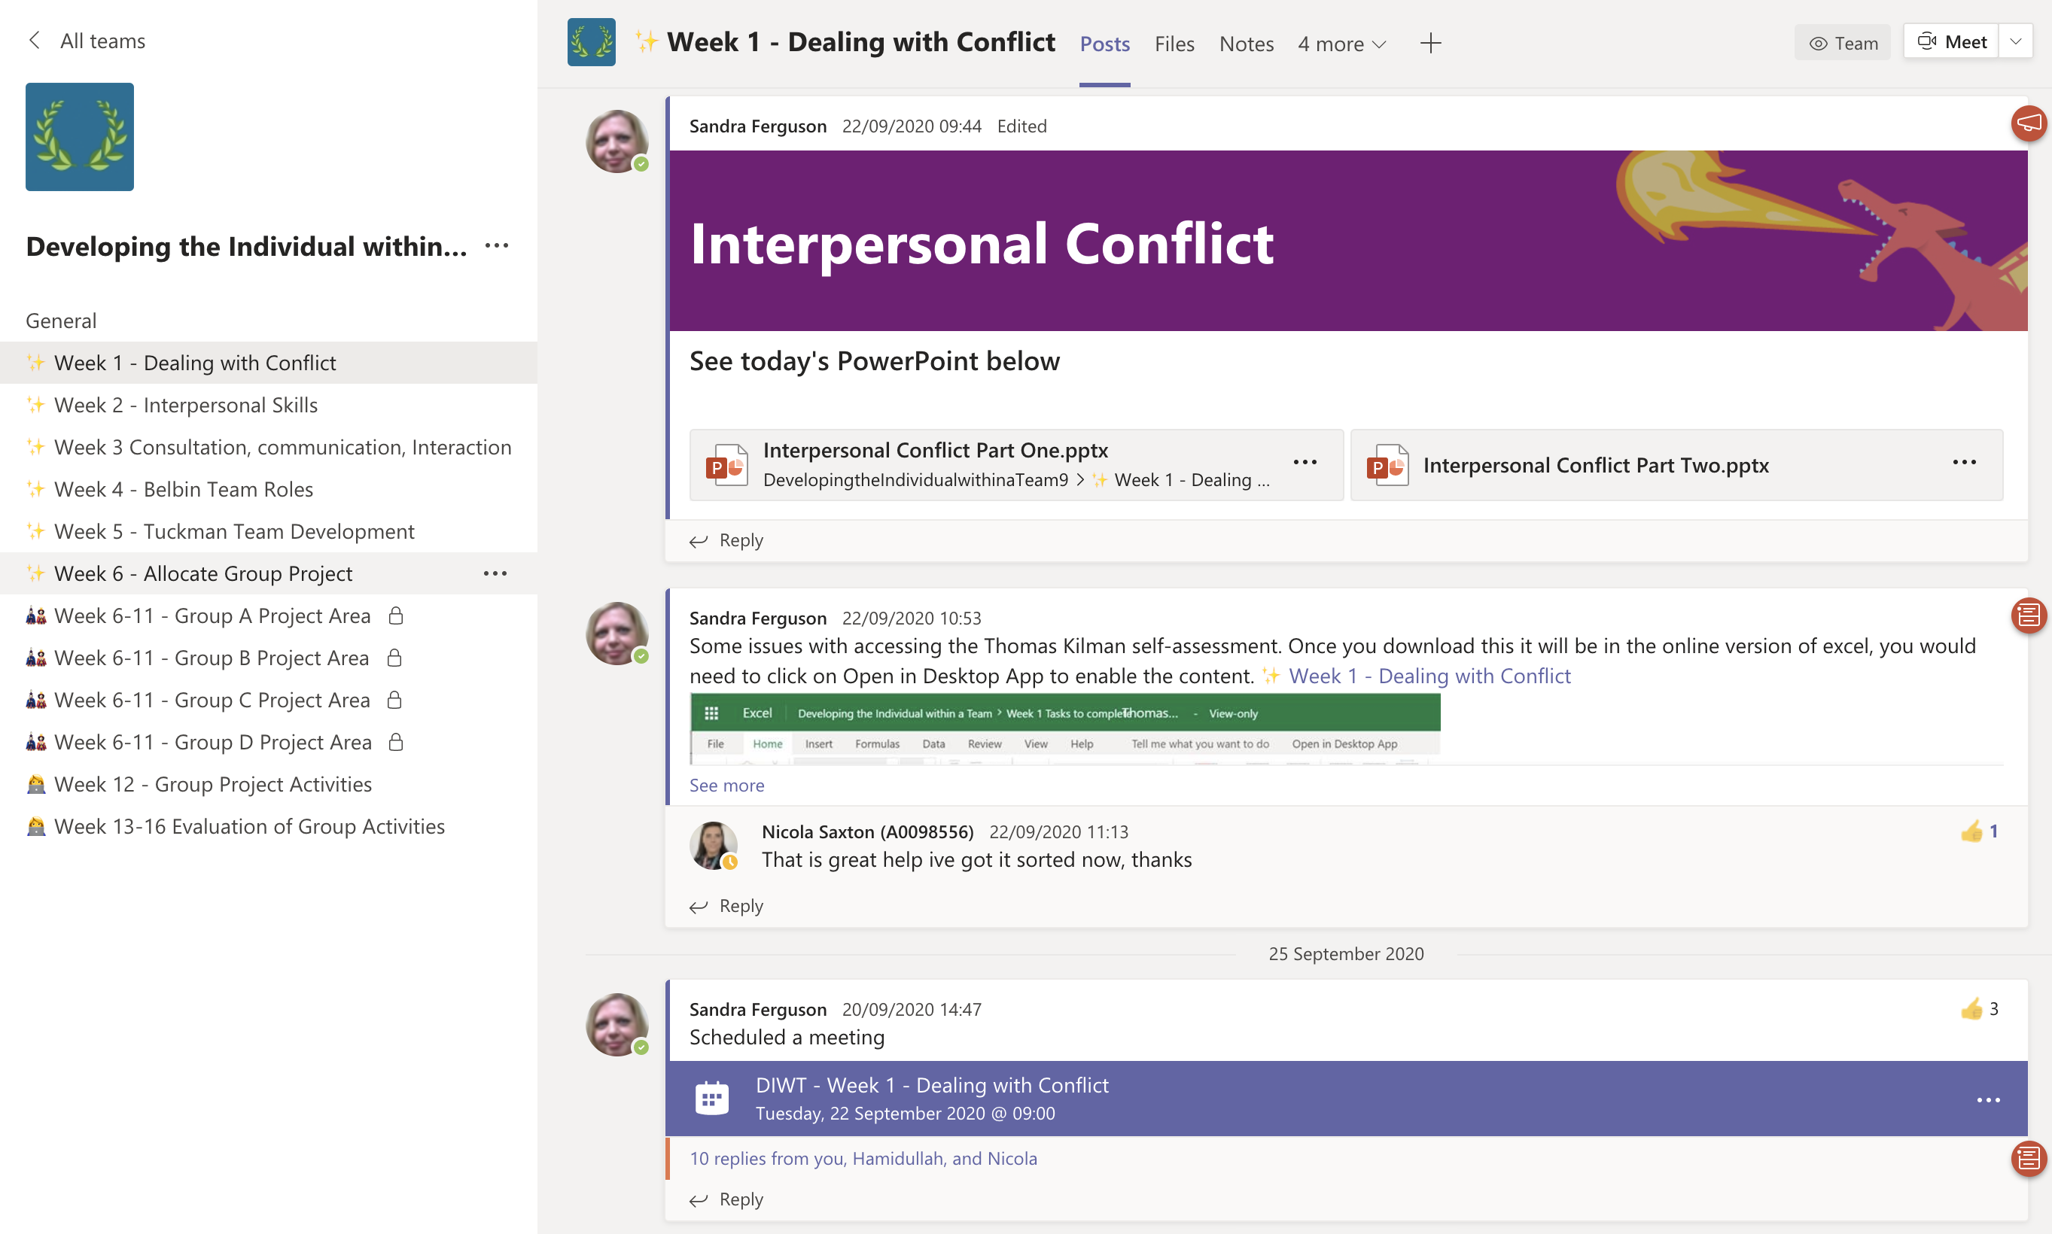
HND Administration & IT

Slide 10
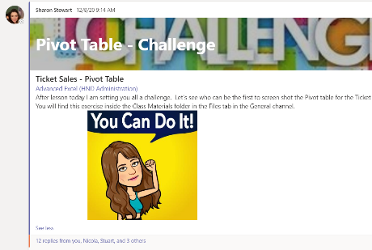
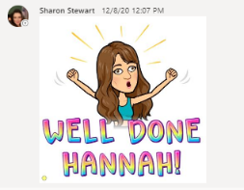
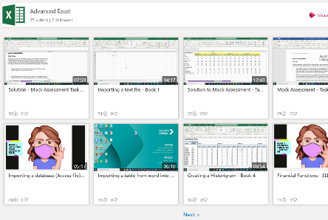
HND Administration & IT

Slide 11
HNC Administration Student Feedback
I found remote difficult at first but as we have gone on, I really enjoy it.
In the beginning I found working remotely frustrating, almost giving up
Lecturer’s videos, chats and recorded lessons I have found invaluable.
I would like to go into College at least a day or two… it can be lonely at times
Lecturers have found ways to teach so that we forget we are remote.
I have struggled to motivate myself…a rollercoaster of emotions

Slide 12
HND Administration Student Feedback
Remote learning has been a challenge…I have pushed myself to be more organised
Technical issues can cause problems; laptop/WiFi/Citrix
Liked how all lecturers have made loads of videos and recorded sessions
Found it difficult not having hard copies of tasks and workbooks, it is a struggle
Remote working has given me more courage to work independently
Lack of motivation and class engagement at times

Slide 13
Lecturer Feedback
Everything takes longer…
Everything had to be re-thought
Delivery feels a bit more formal, less relaxed
Student communication has increased and is time consuming; shift from emails to Teams chat
Creating alternative assessments has been time-consuming
Recording lessons can be used as a reference tool for absentees
Resources created can be used again in the future, saving time next year – Future Proof!

Slide 14
What is next???
Gather qualitative feedback on contributing GU units ongoing, meetings in June to agree grades
Work with other Centres to exchange modified assessments
Reflect on Session 2020-21
Course Team plan for Session 2021-22…

